Slide 1

Autocatalytic Cycle Patterns and Chemical Network Statistics
Jessica Ray
Mentor: Dr. Jim Cleaves

Slide 2
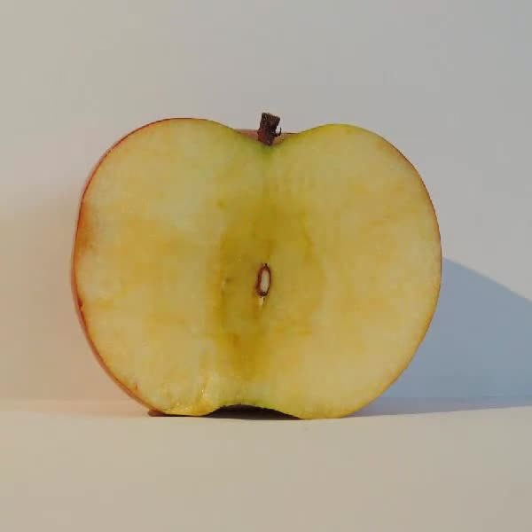
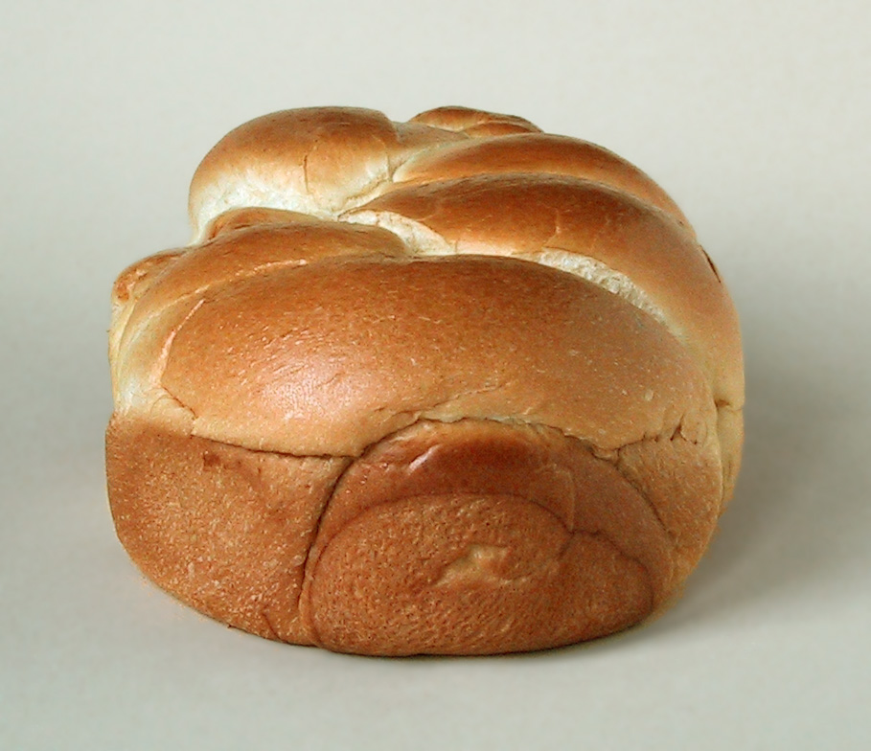
Background: Our Goal with Interesting Reactions
Formose Reaction
Maillard Reaction
What if we had software where we could give it a list of input molecules and reactions, the software would generate an entire chemical network filled with chained reactions? Then, the software would analyze the network to give the user a high-level report to describe the network?

Slide 3
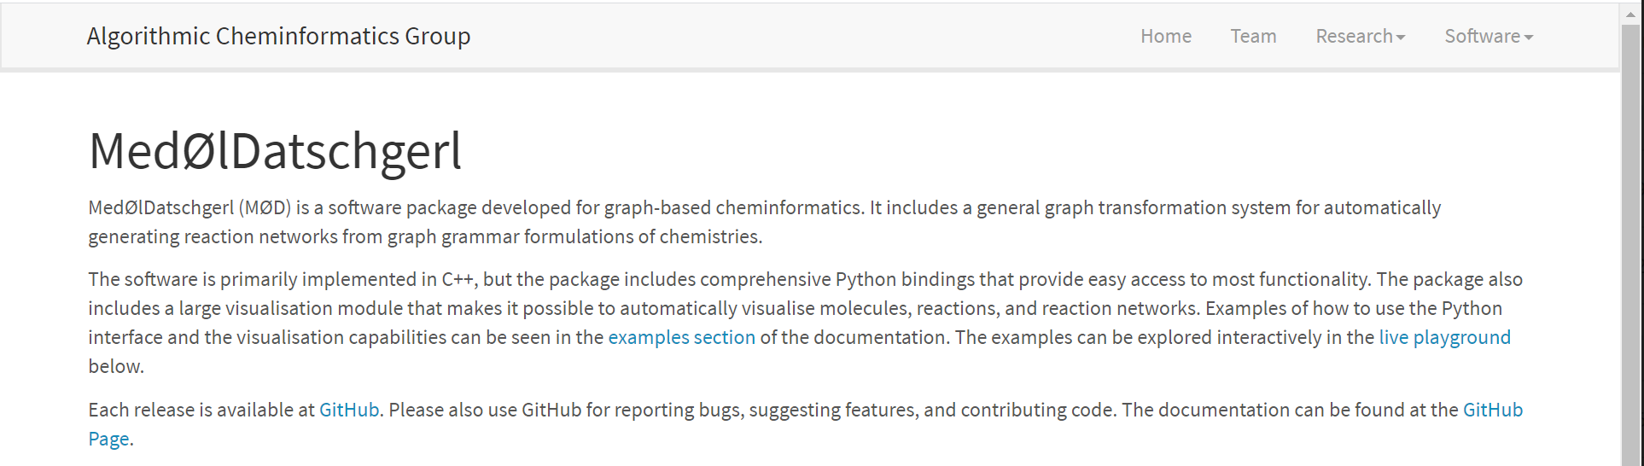
Background: Generating the Network
Creator: Dr. Jakob Andersen
https://cheminf.imada.sdu.dk/mod/

Slide 4
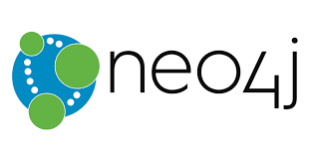
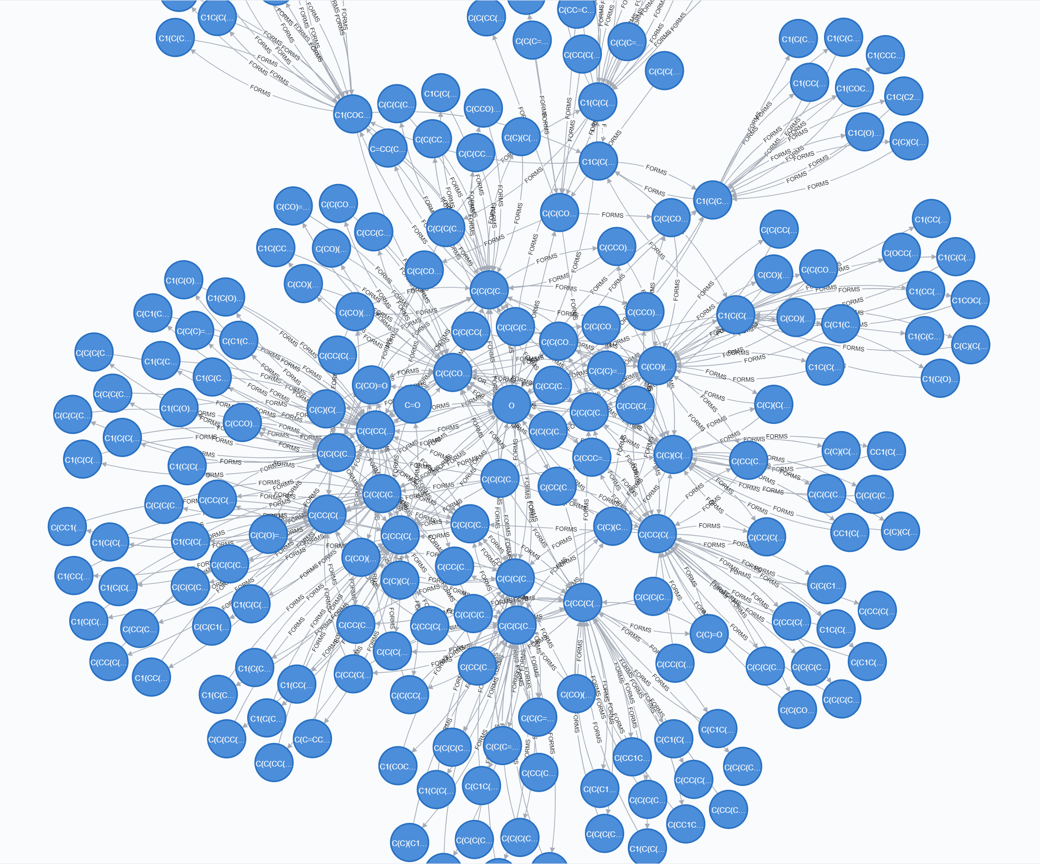
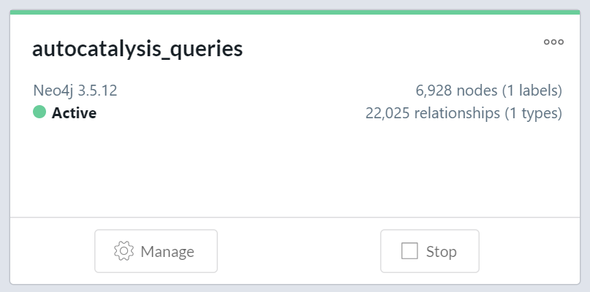
Analyzing the Network
Load the network into a graph database
Get some summary statistics on the network
Query for autocatalytic cycle patterns

Slide 5
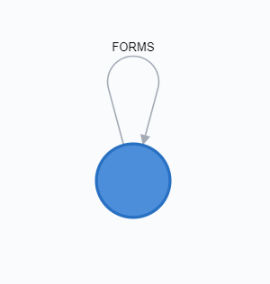
Graph Schema
Molecule Forms Molecule
Each node is a molecule
Each edge is a relationship
If a set of molecules are reactants/products of the same reaction, there will be a relationship between them
Reaction information not lost by not having a Reaction as its own node; reaction ID is stored in the edges (“FORMS”)

Slide 6
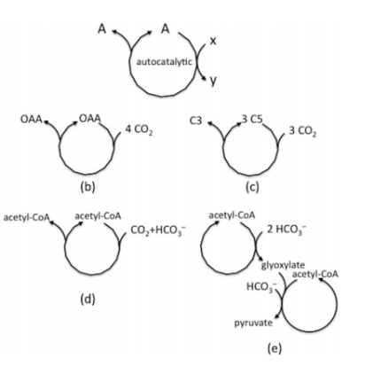
What is an autocatalytic cycle?
Pereto et. al.

Slide 7
How are autocatalytic cycles found traditionally?
Get stoichiometry information for your reaction network
Using stoichiometry, calculate a “current matrix” which will tell you where the stoichiometry “flows” throughout the network
This requires that stoichiometry information is readily available, which is not always the case

Slide 8
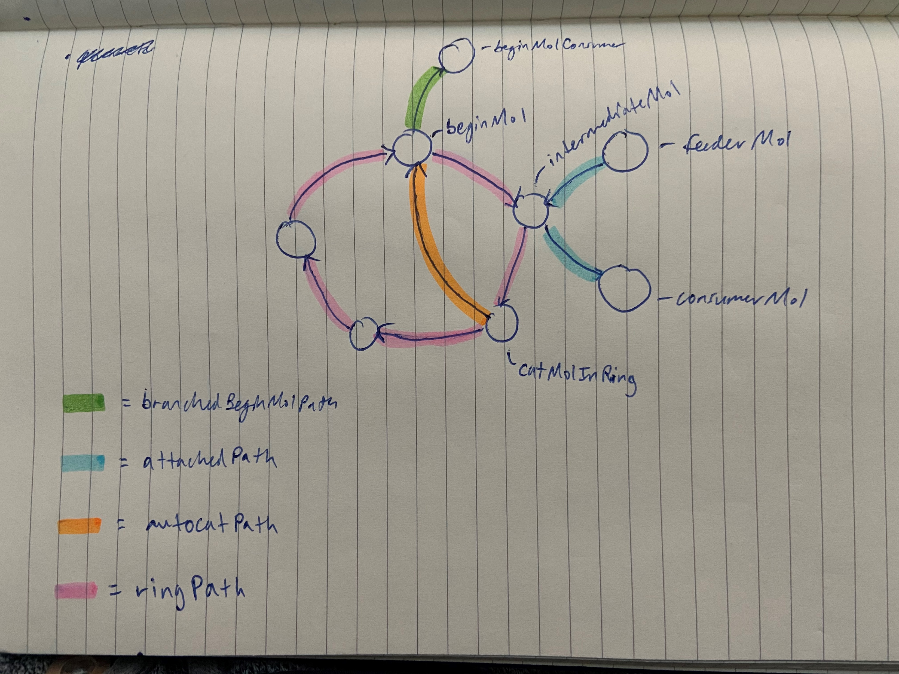
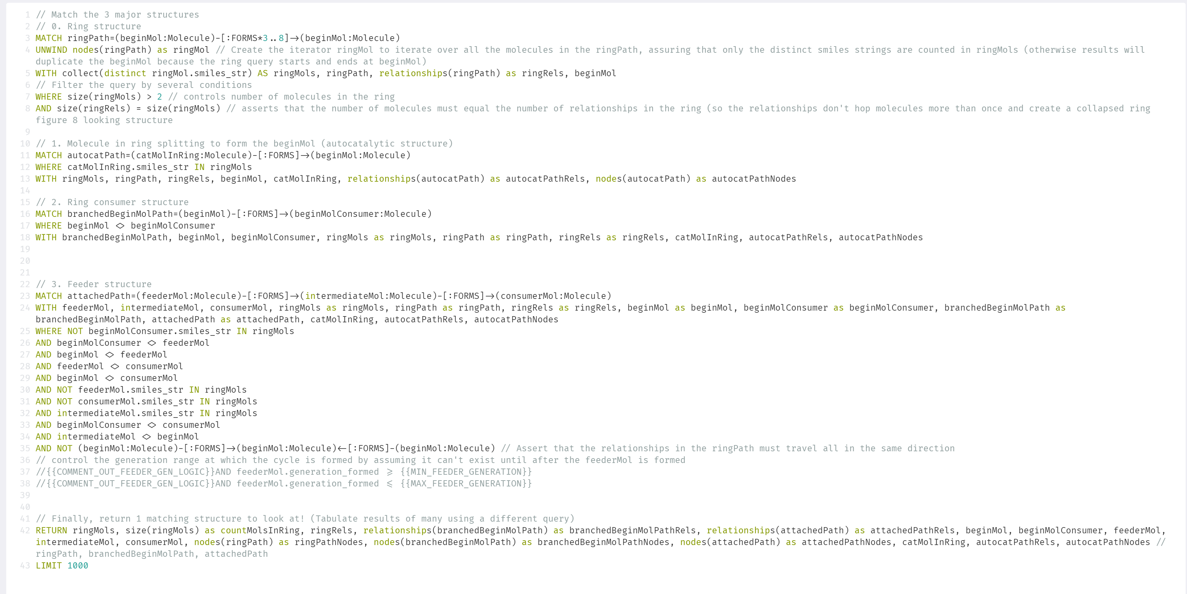
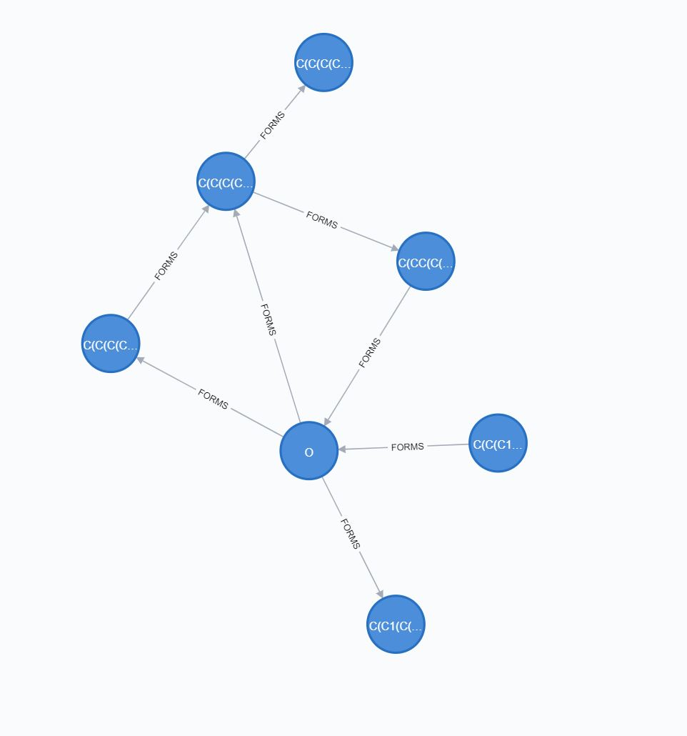
How else can we find cycles? A very specific query

Slide 9
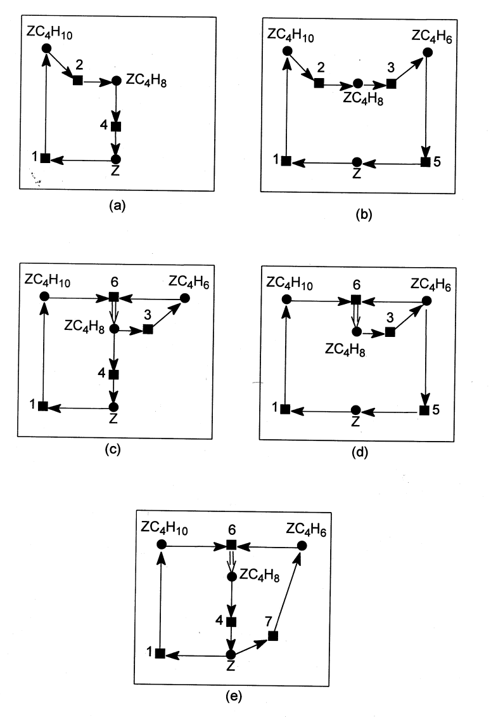
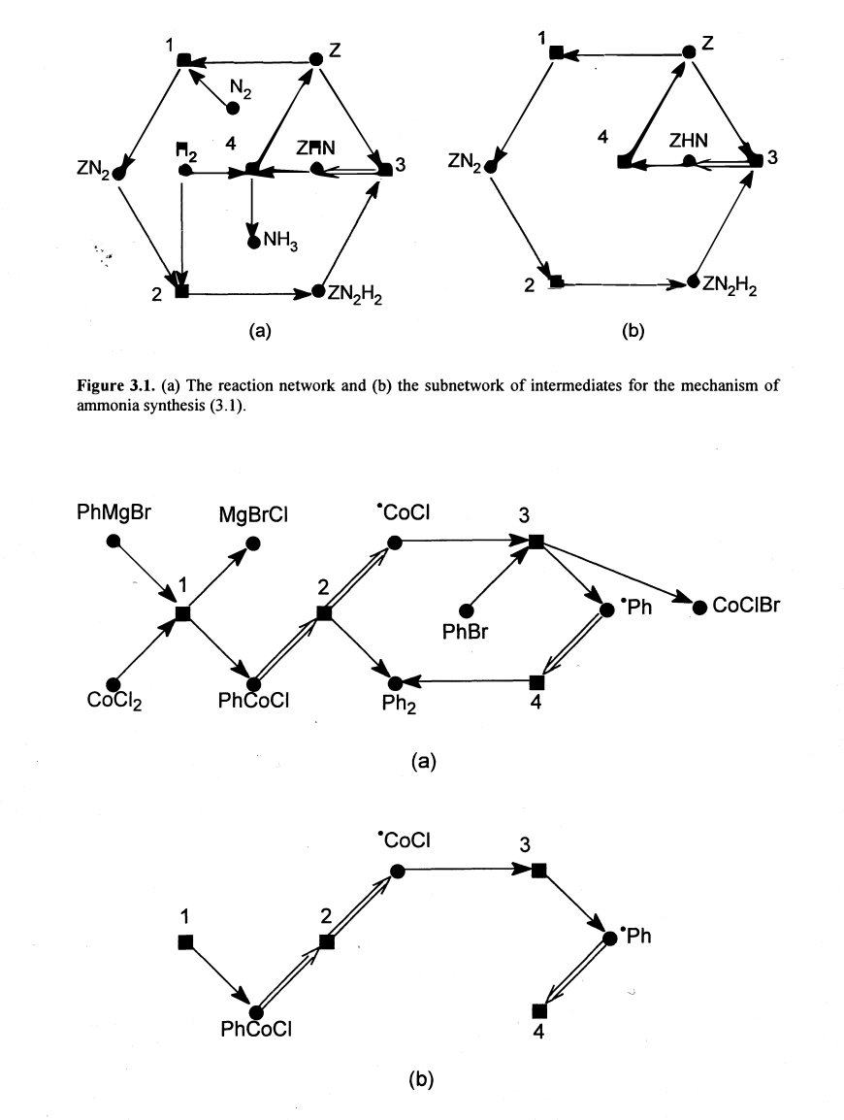
Benefit: Create a query to match whatever pattern you want
Temkin et. al.

Slide 10
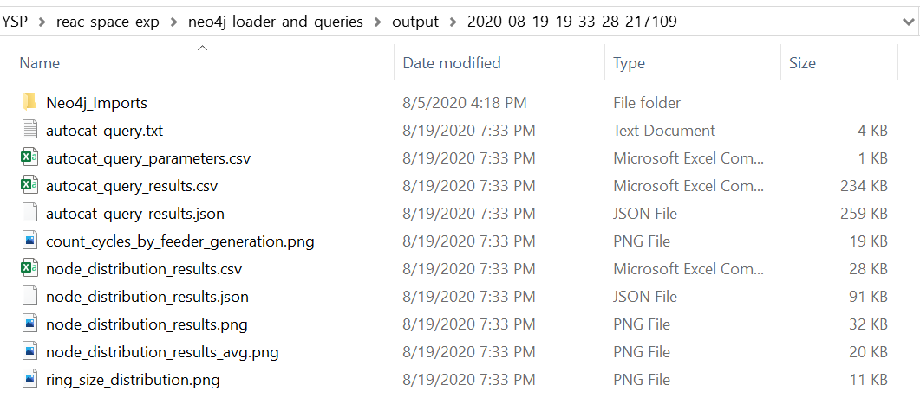
Results
Created several queries
Autocatalytic pattern query
Get count of cycles by feeder generation
Get ring size distribution
Node summary query
Get node degree distribution plot
Input conditions and resulting data/plot images are saved to a timestamped output folder (see right)

Slide 11
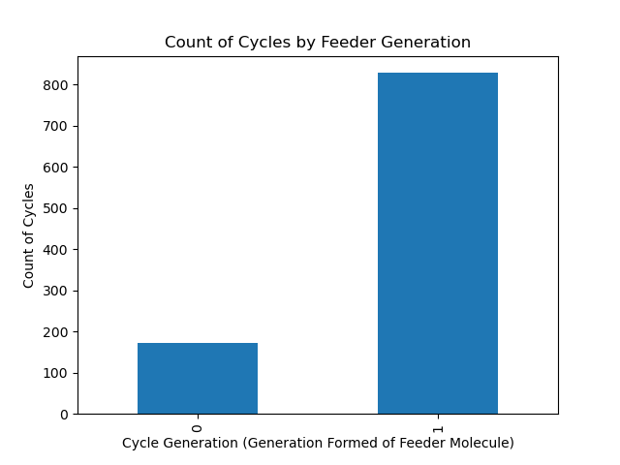
Results: Count Cycles by Feeder Generation

Slide 12
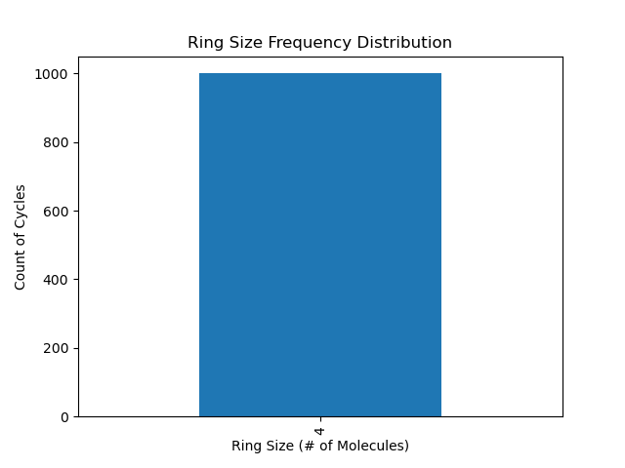
Results: Ring Size Distribution

Slide 13
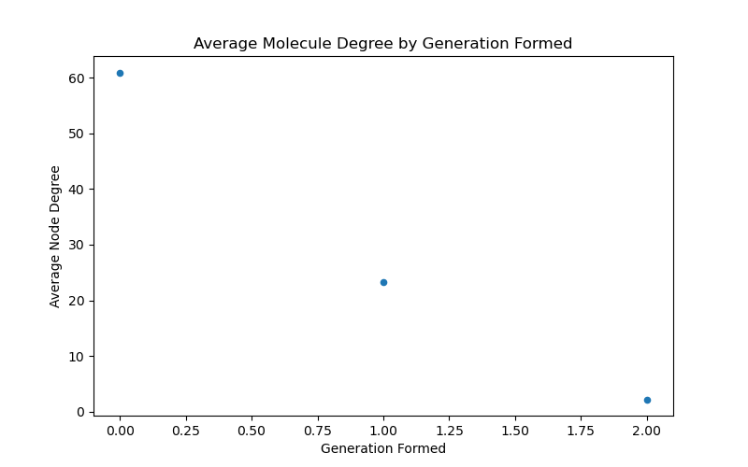
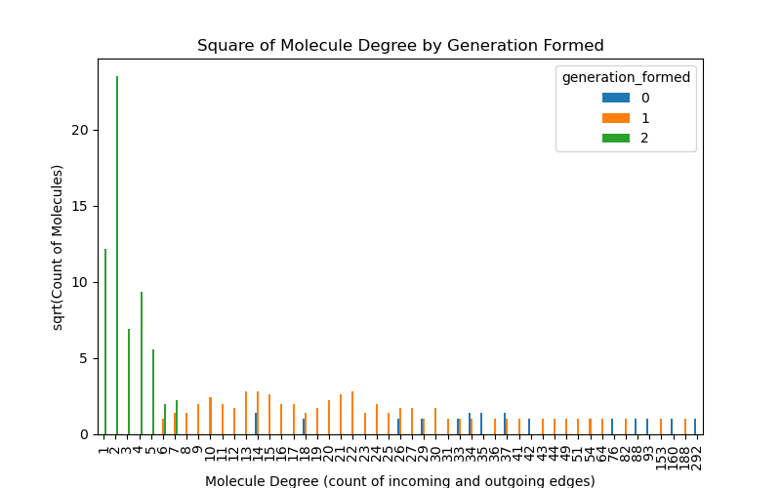
Results: Node Degree Distribution: Incoming and Outgoing Relationships

Slide 14
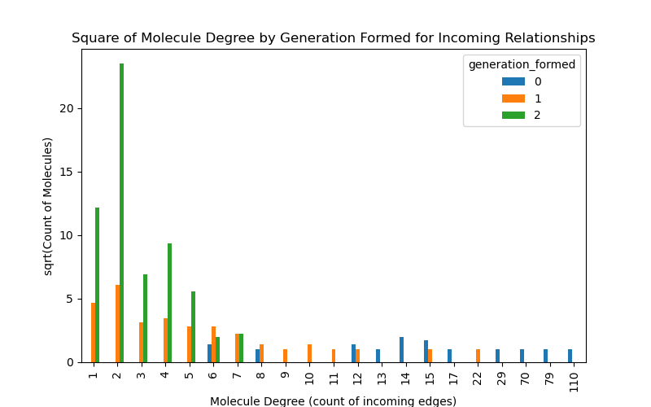
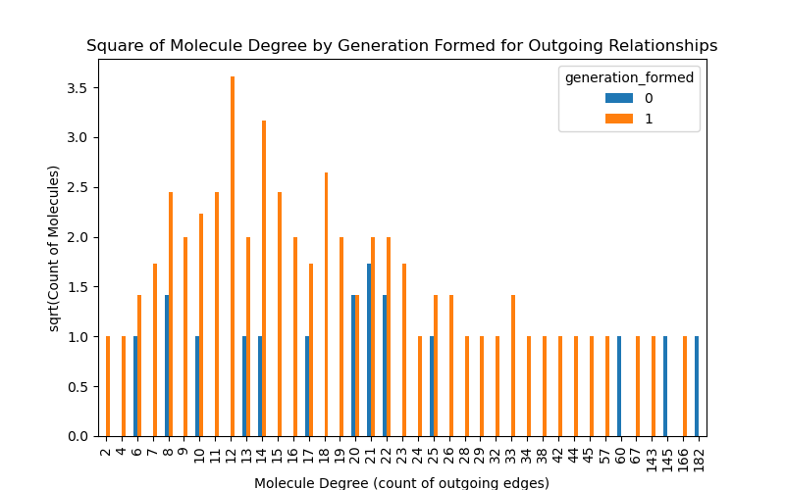
Results: Node Degree Distribution: Incoming OR Outgoing Relationships

Slide 15
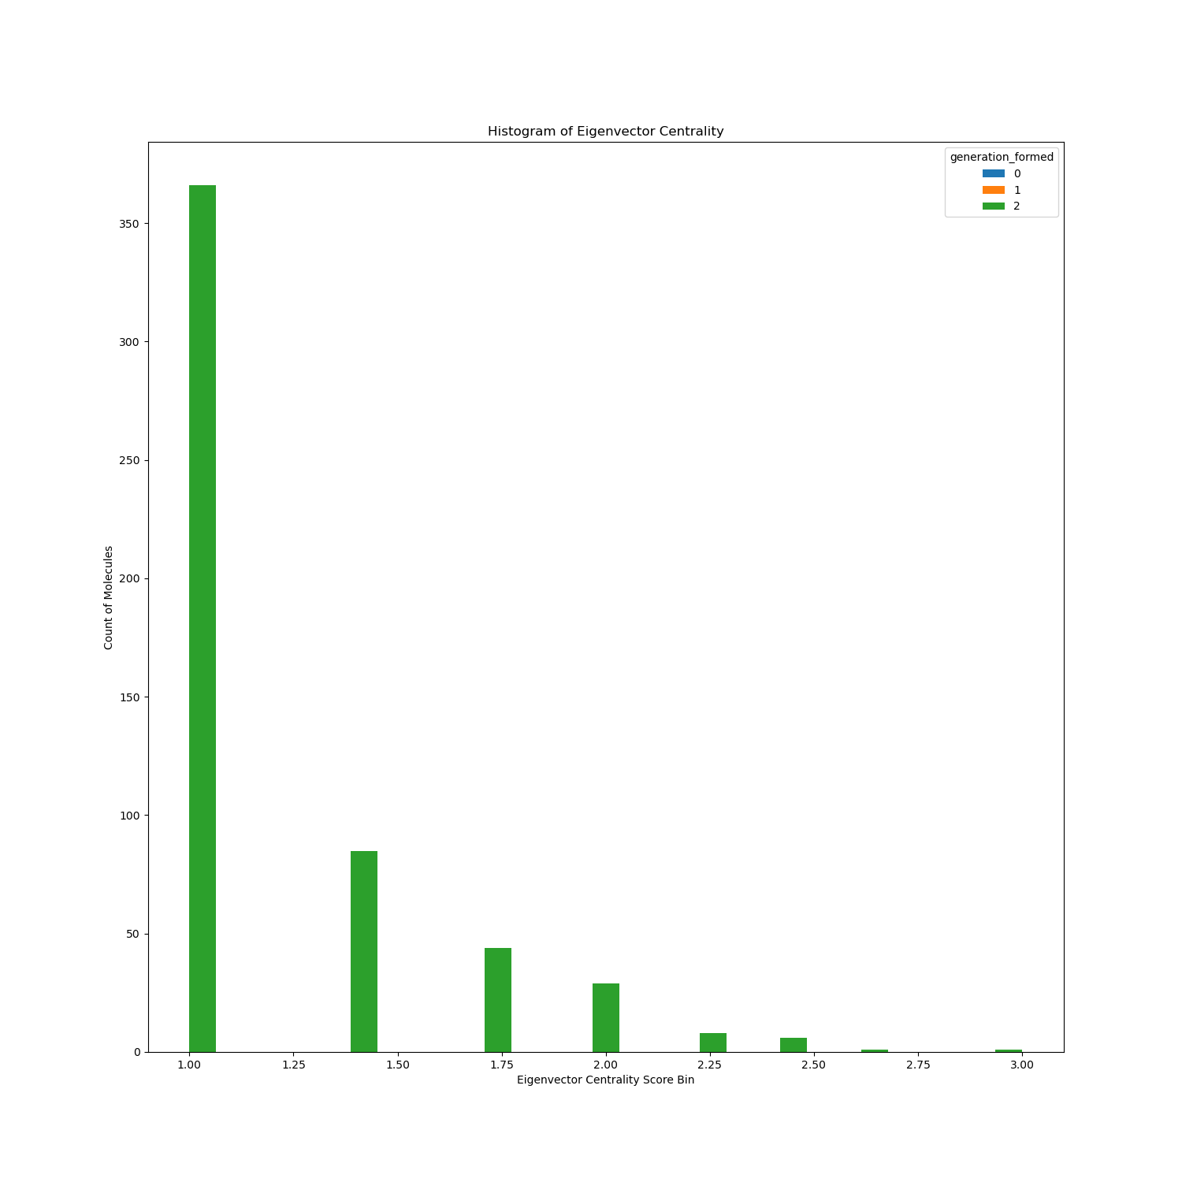
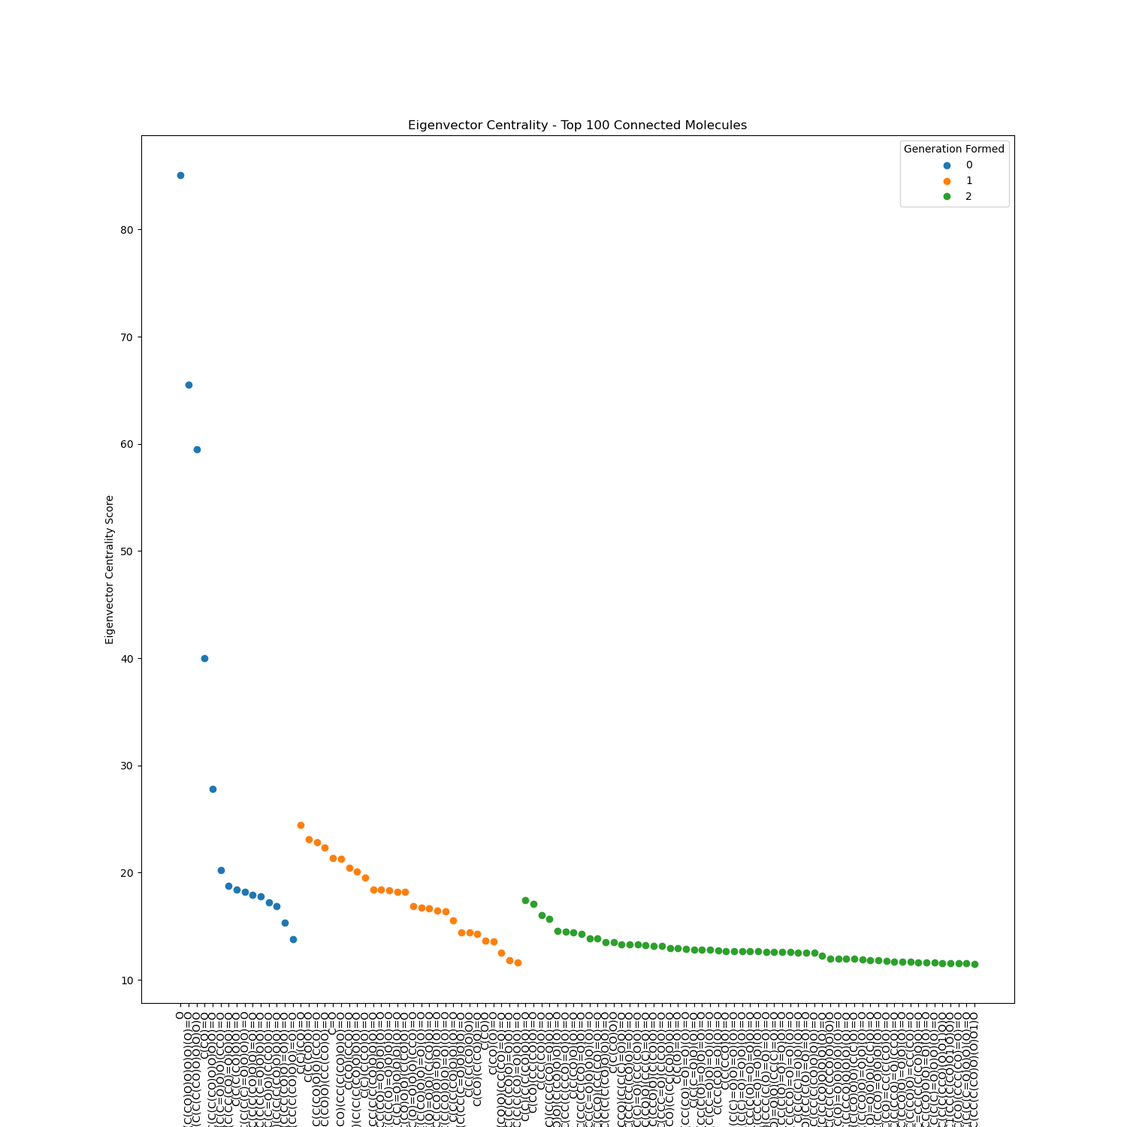
Results: Eigenvector Centrality

Slide 16
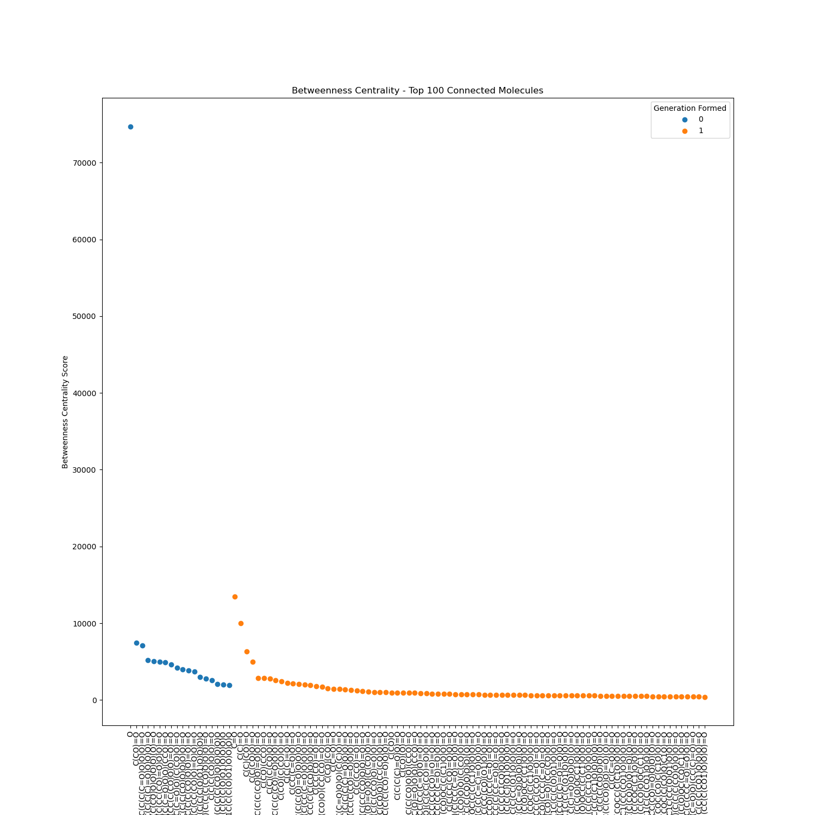
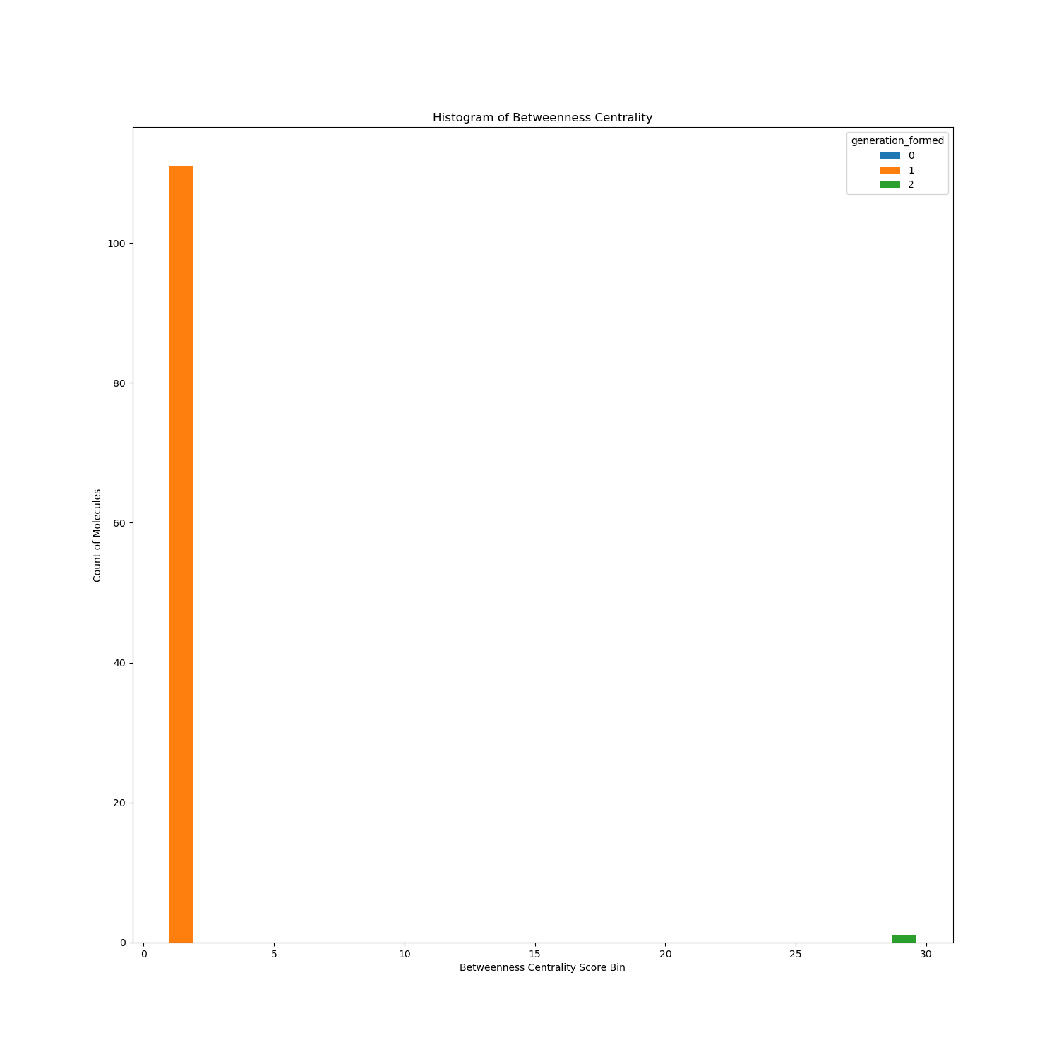
Results: Betweenness Centrality

Slide 17
Conclusion
Graph database platforms are useful tools to find specific structures/patterns in a chemical reaction network
Storing the network in a graph database allows for easy retrieval and pattern matching / statistics across the network
Larger rings were more likely in the network, due to there being more combinations possible
In general, the older the molecule in the network, the more edges it accumulates with each generation
As the network generation increases, the number of autocatalytic patterns increases. Generation 0 to 1 saw a ~5x increase in patterns matched. However, this ratio is not exact, because only a portion of the graph was sampled.
Betweenness Centrality and Random Walk Betweenness Centrality were both evaluated, and the network was small enough such that the Random Walk result was the same
Molecules in the network tend to have many more incoming than outgoing edges, suggesting that molecules in the network are more likely to be products than reactants

Slide 18
Future Considerations
Weigh each edge with information on energetic favorability (such as Gibbs Free Energy)
Query for cycles ordering by overall highest energetic favorability
Need to optimize autocatalysis pattern matching query so that more generations can be loaded into the database
Query time/complexity significantly increases with each added generation
Use a cloud hosted solution to offload the compute to a more powerful machine / cluster

Slide 19
Thank you!
Thank you to Dr. Jim Cleaves, Dr. Andersen, Alejandro, Aayush, and Siddhant!

